Slide 1

CARBON FOOTPRINT CALCULATOR
-Debdatto Mukherjee
-Kiran Babu, Mendu (lead)

Slide 2
A carbon footprint is the total sum of greenhouse gas (GHG) emissions caused by an organization, event, product, or person. As we are aware, the increasing concentration of GHGs in the atmosphere can accelerate climate change and global warming, it is very necessary to measure these emissions from our day-to-day activities. The first step towards managing GHG emissions is to measure them. There are some standards and guidelines to measure GHG emissions like GHG protocol, ISO 14064, the more comprehensive one Life Cycle Assessment (LCA), market-based mechanisms like Clean Development Mechanism (CDM), and Voluntary Carbon Standards (VCS), etc.
What is a Carbon Footprint?

Slide 3
Step 1- Data collection.
Electricity: Collect data on your annual electricity bills. You can find the number of power units (In India, one unit = 1KWh of electricity) consumed in your home from the monthly electricity bills issues by State Electricity Board/ Distribution/Collection companies. Take monthly consumed units and then multiply them by 12 (No of months in a year).
Petrol/Diesel: Add the number of liters of petrol/diesel you used in your car/motorcycle in a year. If you do not remember the exact value right now, please add average values.
LPG: Generally, one LPG cylinder has around 14 kg of liquefied petroleum gas. Multiply the number of cylinders used in a year by 14 and add the resulted value in the calculation.
How to calculate Carbon Footprint?

Slide 4
Step 2- Calculation Methodology.
Electricity : Input value (in KWh/Yr) X 0.85 (Emission Factor) = Output value in (Kg of CO2)
Petrol: Input Value(In Litres/Yr) X 2.296(Emission Factor) = Output value in (Kg of CO2)
Diesel: Input Value(In Litres/Yr) X 2.653 (Emission Factor) = Output value in (Kg of CO2)
LPG: Input Value(In Kg/Yr) X 2.983 (Emission Factor) = Output value in (Kg of CO2)
Your Carbon Footprint : Add (1+2+3+4) = Output value in (Kg of CO2)
How to calculate Carbon Footprint?

Slide 5
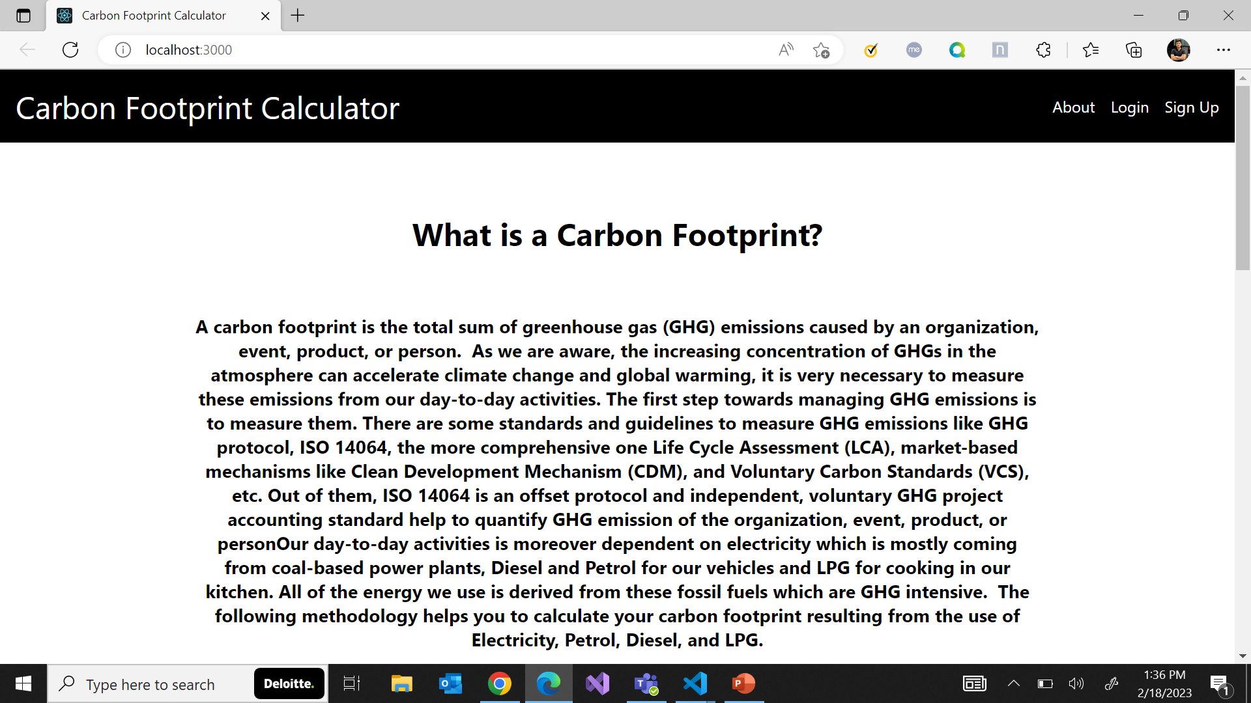
Carbon Footprint Calculator
Tools used :
Microsoft SQL Server Management Studio 18
Microsoft Visual Studio Code 2022
Microsoft Visual Studio Code
Technologies used :
SQL Server
.net framework 4.7.2 (WEB API)
React JS

Slide 6
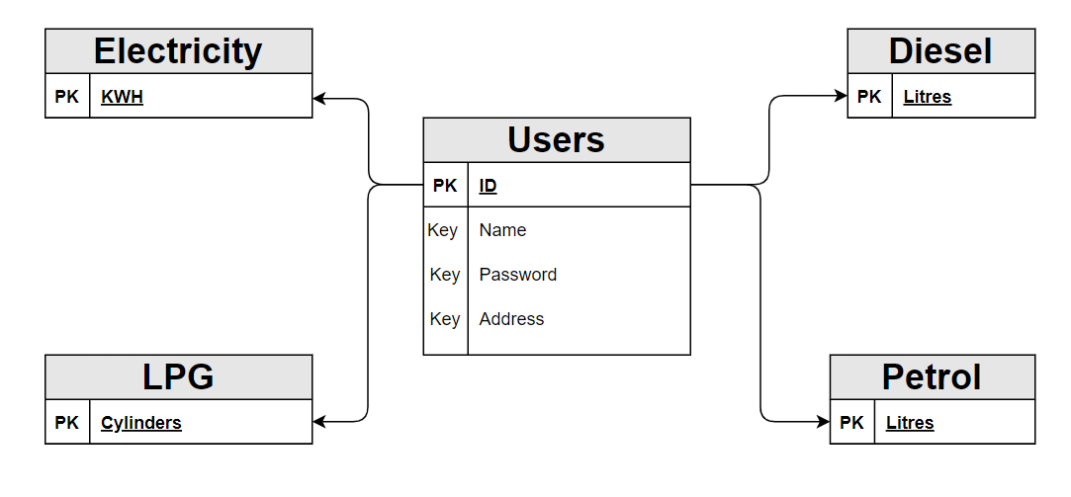
Entity-Relationship Diagram

Slide 7
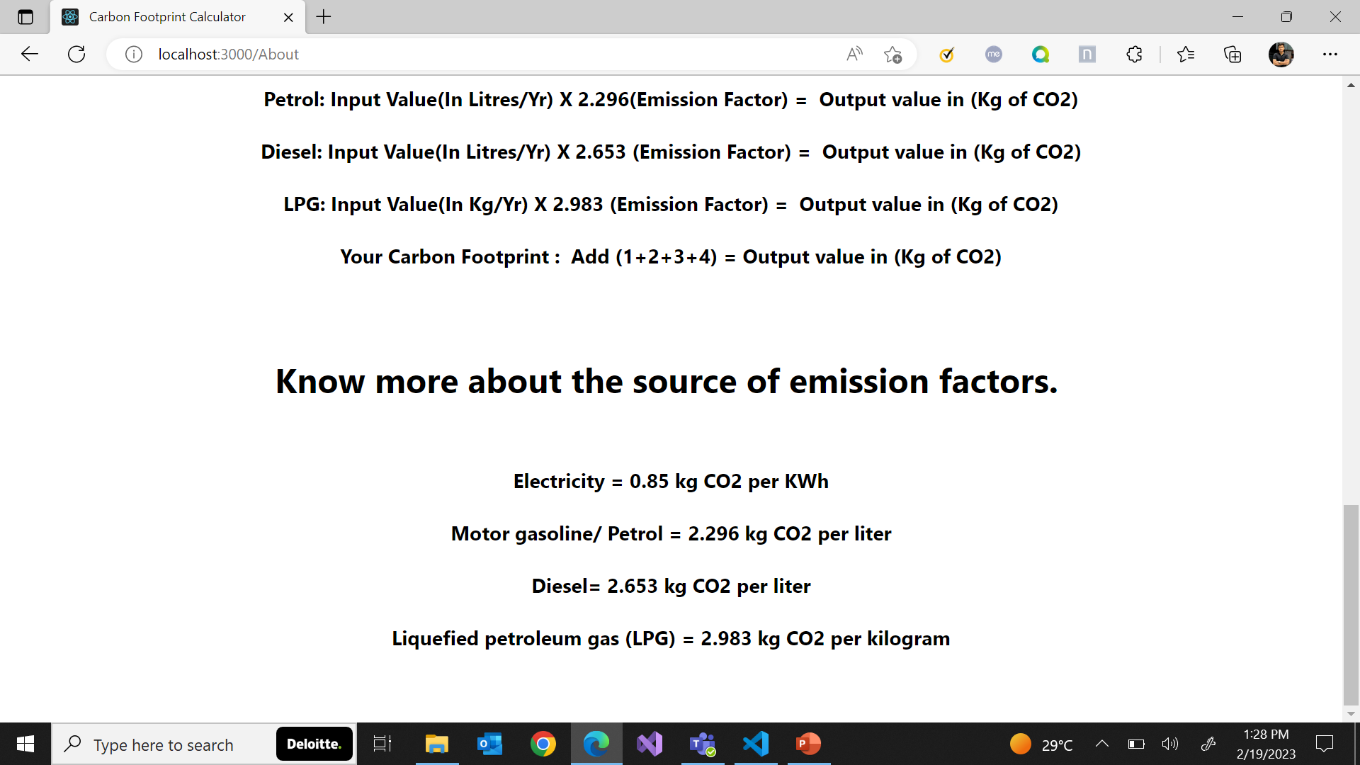
About
A brief introduction about what the purpose of the calculator web application does, how it does and why is it necessary to do so.

Slide 8
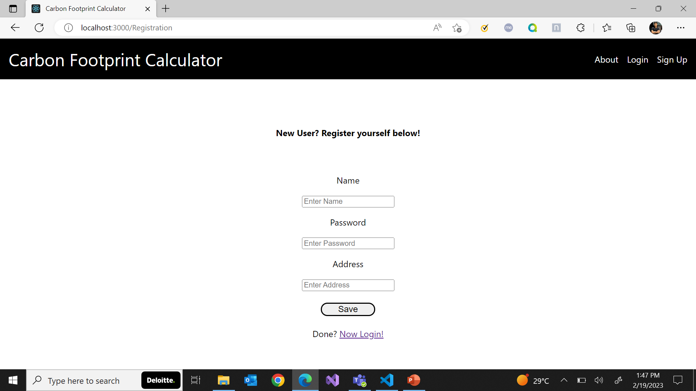
Registration
Upon clicking ‘Sign Up’ on the navigation bar, users will be redirected to this page where if they don’t have any previously created accounts, they can register themselves by filling the required details.

Slide 9
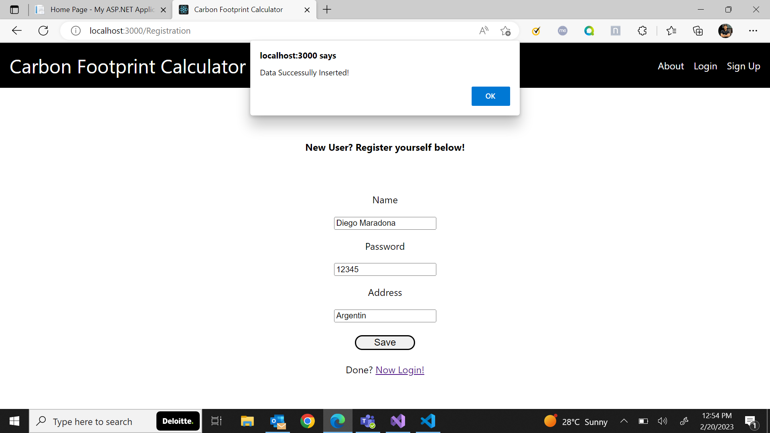
Registration
Success alert message upon registering a user properly. After which the user can click on ‘Now Login!’ to login with the authorized credentials for accessing the main application.

Slide 10
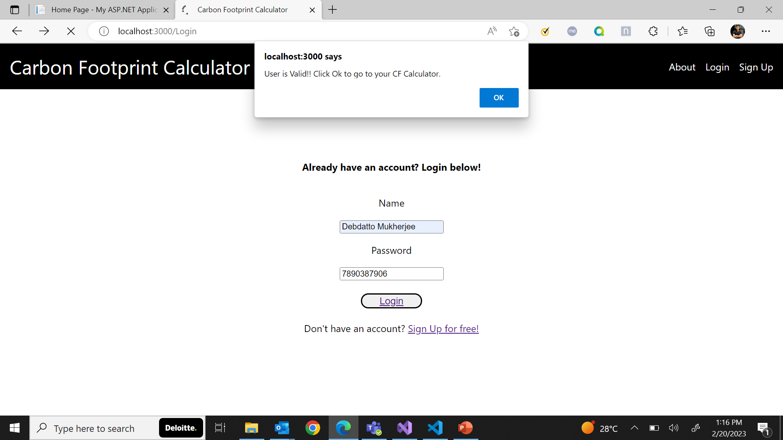
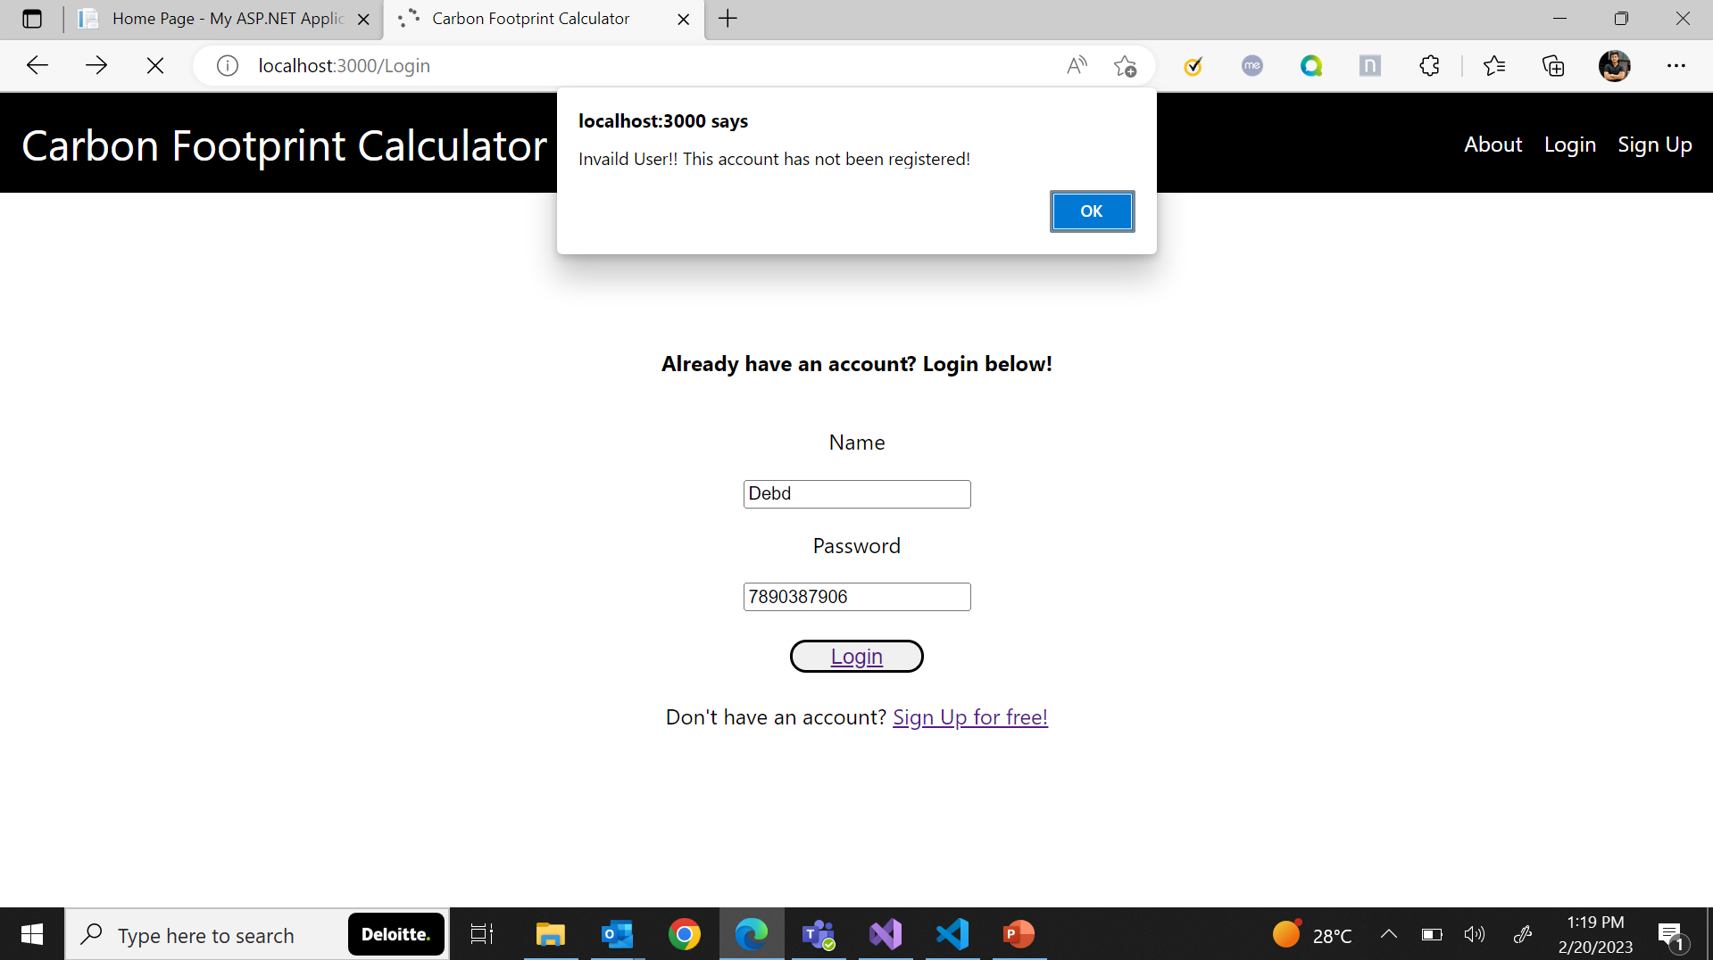
Login
Success alert message upon authentication and authorization. Clicking ‘Ok’ will redirect them to the calculator.
Invalid user alert message after failed authorization and they would need to try again to gain access.

Slide 11
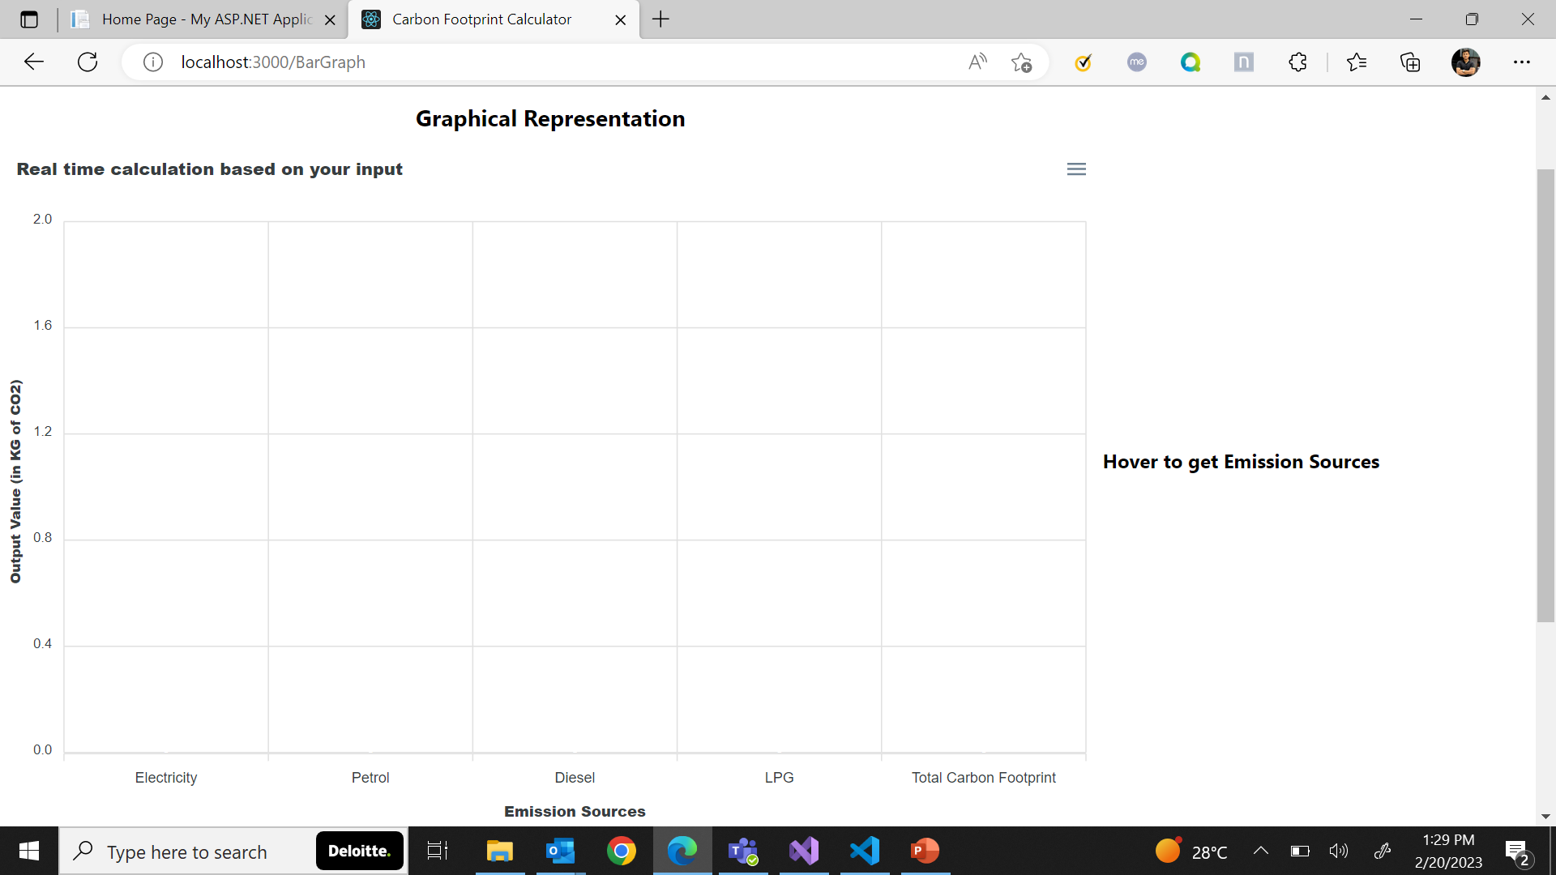
Calculator
Users will be redirected to the main carbon footprint calculator upon successful login. Here, the calculation is based on user input for four different categories which can be accessed upon a simple mouse hover over the ‘Hover to get dropdown menu’ and the results are displayed on a dynamic real-time graph which keeps changing as per user’s input values.

Slide 12
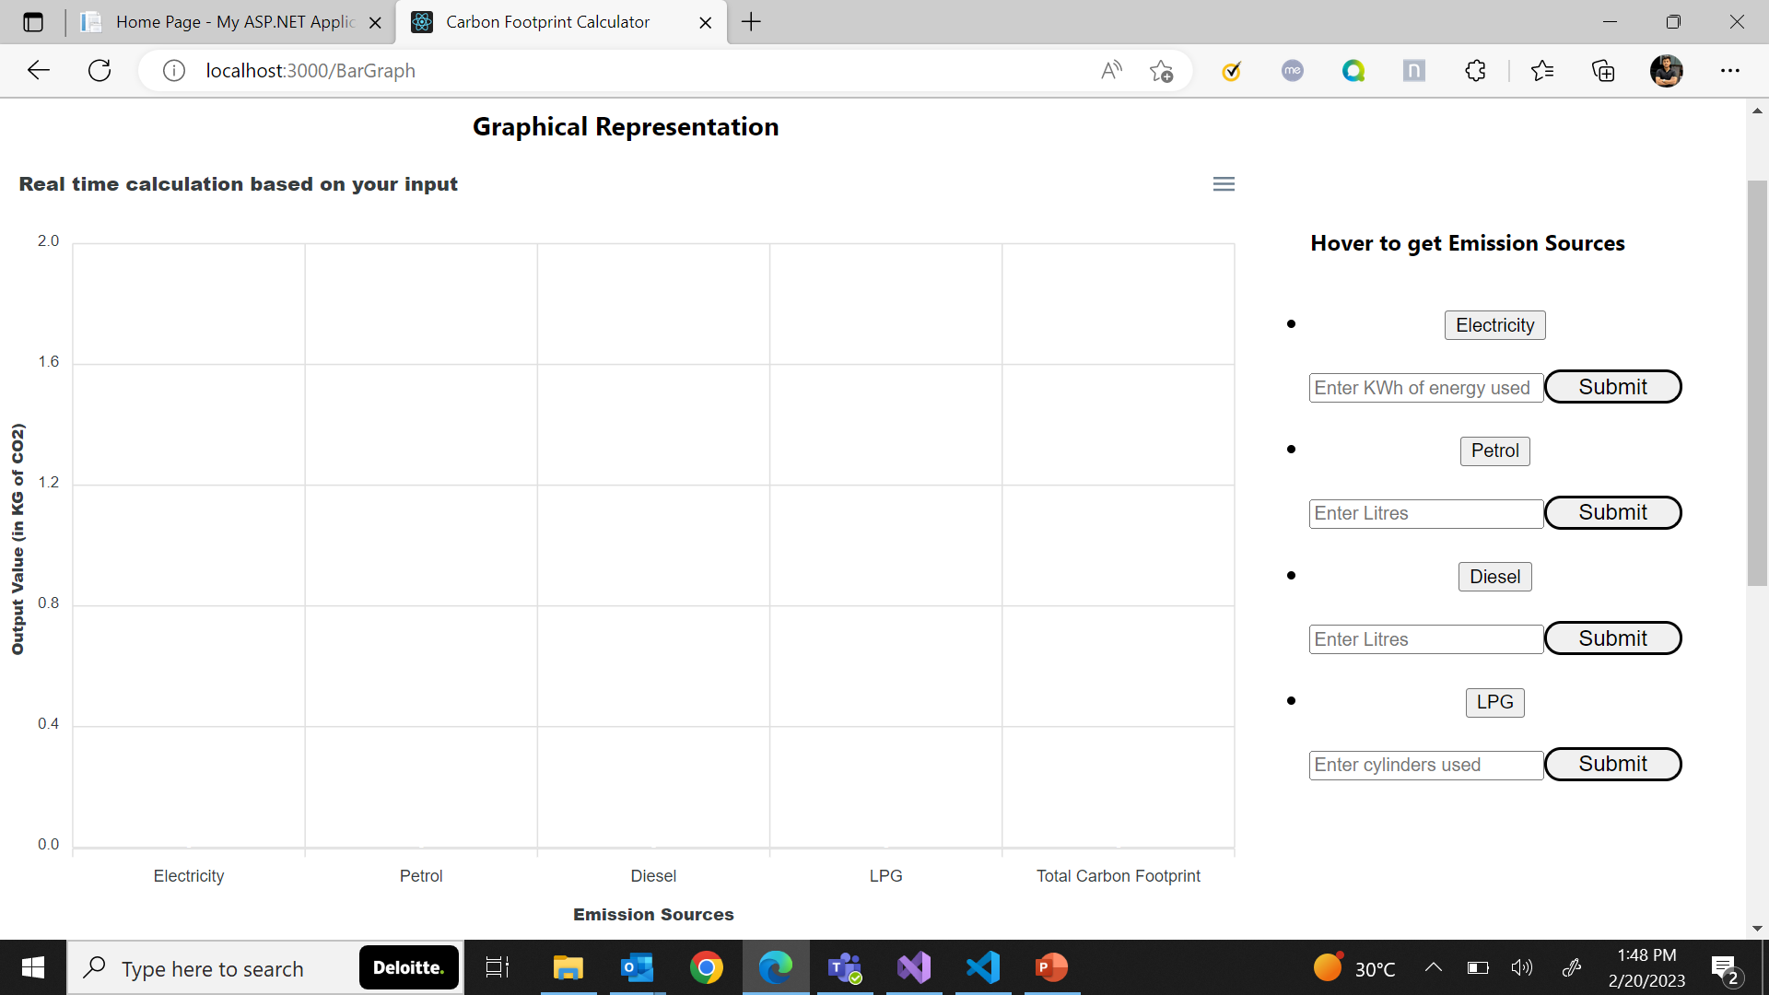
Calculator
Upon mouse hover, users will gain access to a responsive dropdown with four different categories in which inputs of different metrics can be stored in the database upon clicking ‘Submit’ and the corresponding changes will be reflected on the real-time graph. A simple mouse hover over the bar graph will also lead the users to the formula based on which the real-time calculation is taking place in the back-end.

Slide 13
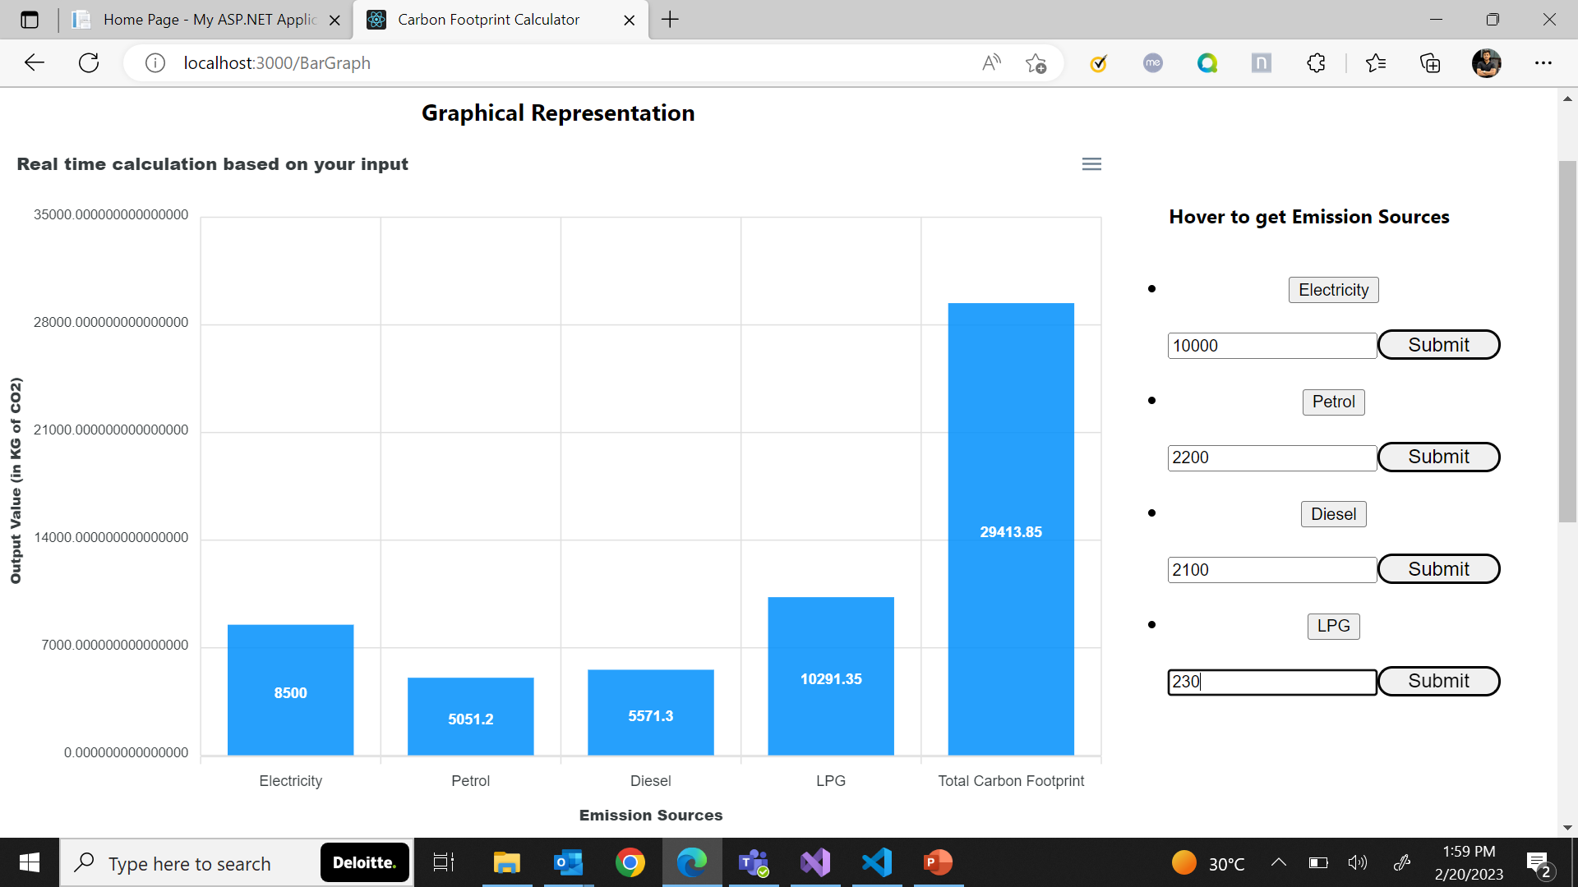
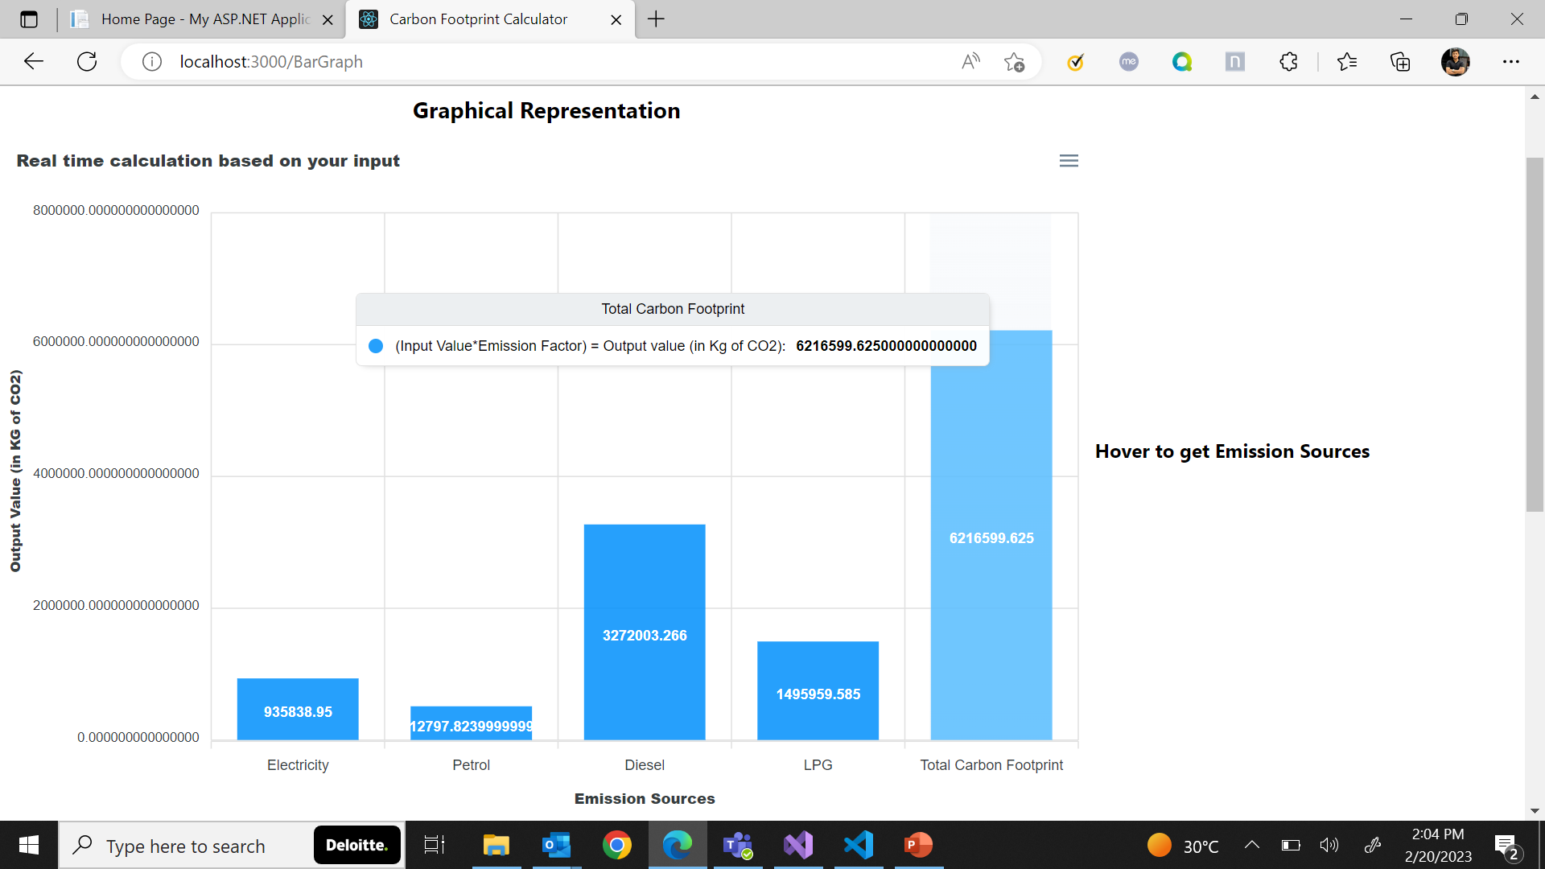
Calculator

Slide 14
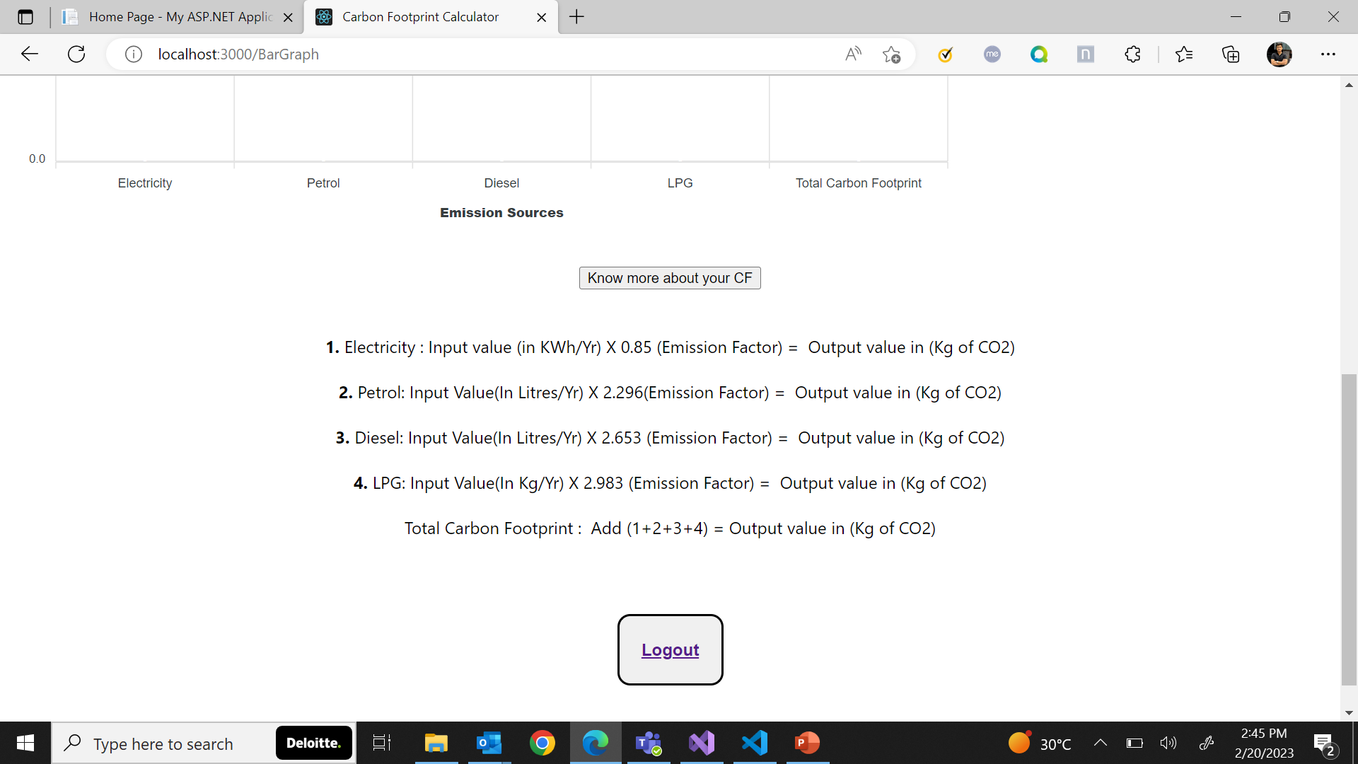
Calculator
Users can scroll down and check out the formulas based on which the calculation on the graph is taking place.
Down below, they will also find a logout button, which will log them out of the application once they are done.

Slide 15
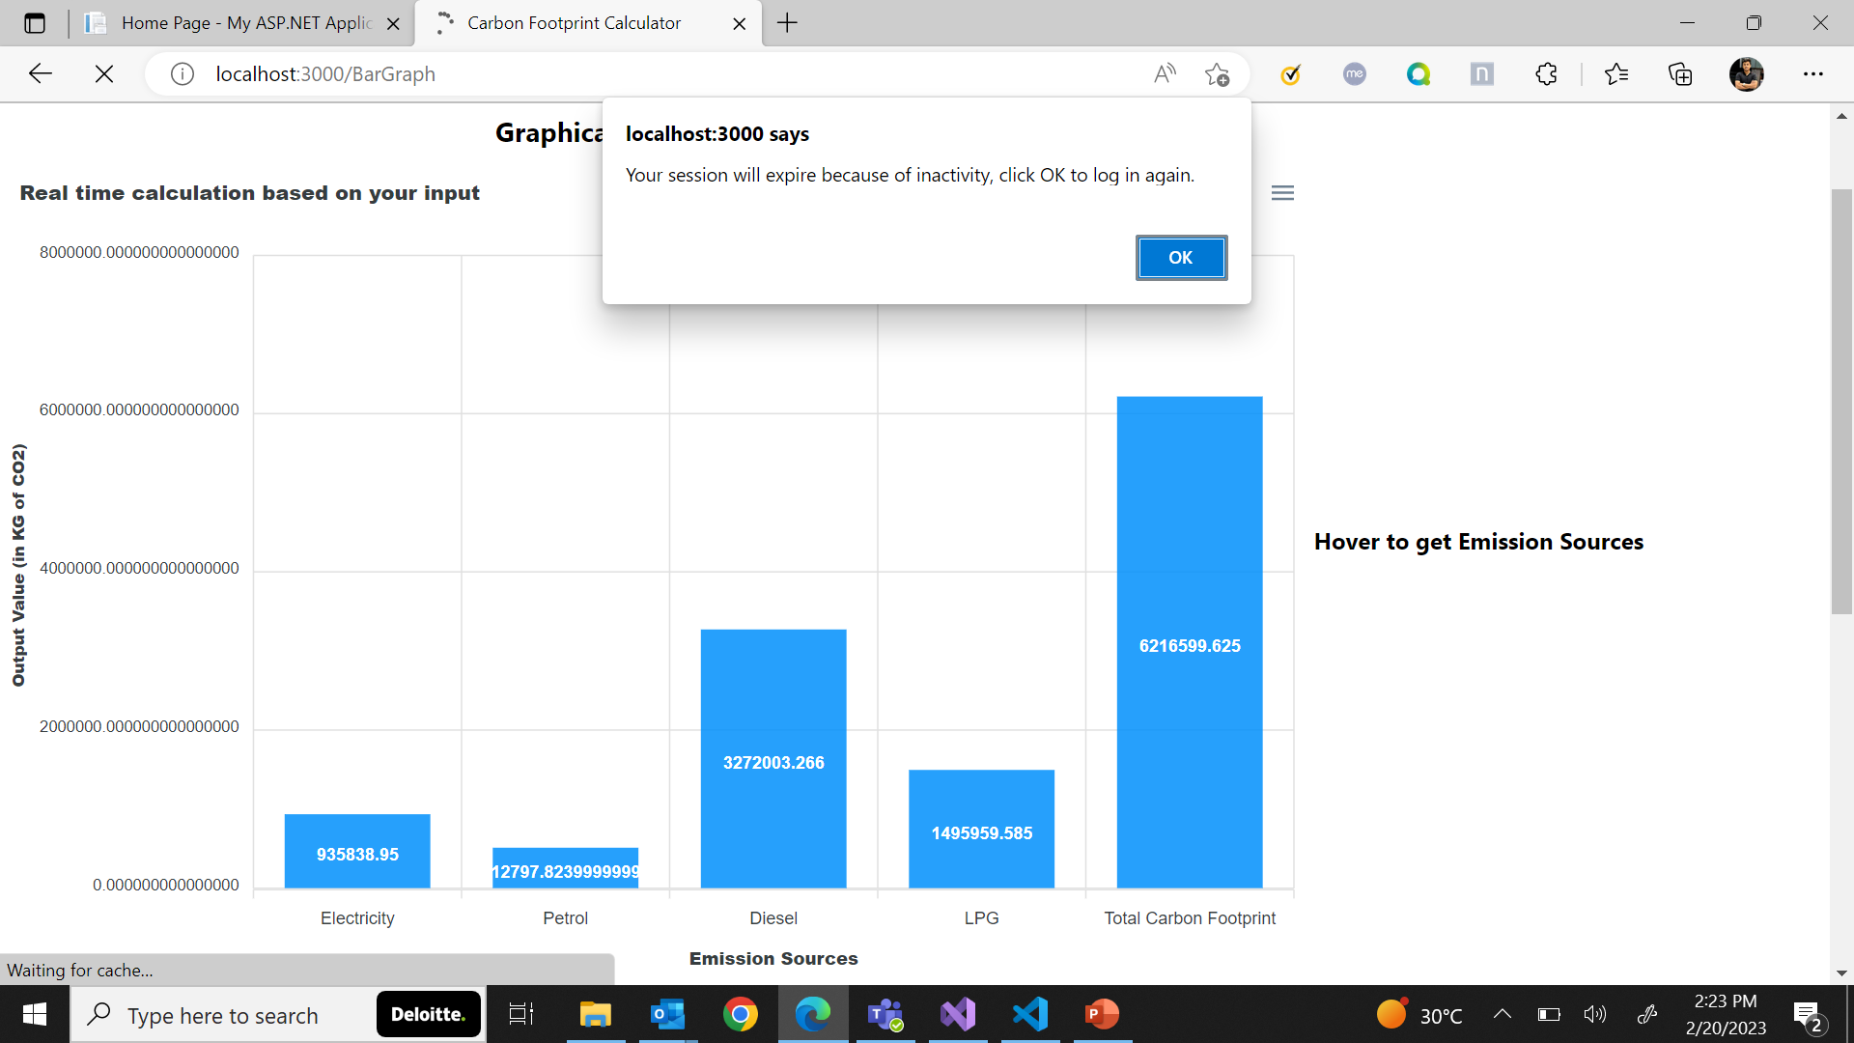
Session Expiry
After 10 minutes of inactivity, the user’s session token will expire, and an alert message will appear on the screen alerting about the auto-logout, which will also lock the entire page, making anyone unable to access the calculator without logging in again. This is a vital step taken to ensure the security of the application.

Slide 16
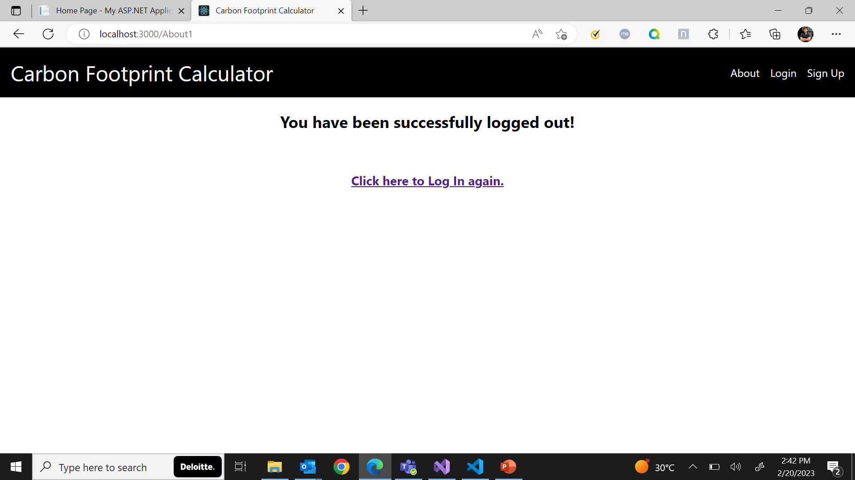
Logout
User will be logged out after inactivity or after simply clicking ‘Logout’ where they will be led to this page from where they can either log in again or they can simply exit the application.

Slide 17
https://deloittedevelopment.udemy.com/course/react-the-complete-guide-incl-redux/
https://deloittedevelopment.udemy.com/course/react-the-complete-guide-incl-redux/
Exception Handling and Logging in ASP.NET Core Web API (codingsonata.com)
C# Corner - Community of Software and Data Developers (c-sharpcorner.com)
GeeksforGeeks | A computer science portal for geeks
References

